Slide 1
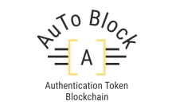
E KYC UNIVERSAL ID FOR IMMIGRANTS
TEAM - AUTO BLOCK
Steve Clarke
Cindy Ooi
Desmond Tan
Shamsul Amry
Jaya Kumar

Slide 2
3
2
1
4
5
PROBLEM STATEMENT
Immigrants do not have proper personal identification documents
Immigrants are not able to receive welfares
Food supply
Education
Medical treatments
Employment
Government officials have a hard time tracking immigrants
Whereabouts
Total number of immigrants still in country

Slide 3
3
2
1
4
5
Number of immigrants in Malaysia in (in thousands)

Slide 4
3
2
1
4
5
OBJECTIVE
Create an E-KYC solutions for the immigrants.
Eliminates asymmetry flow of information between all actors
Create employment opportunity for immigrants
Utilize available resources in various sectors

Slide 5




3
2
1
4
5
MVP SYSTEM DESIGN
E-KYC
Authentication Blockchain Engine
Register or Authenticate
Register or Authenticate
Universal ID
Universal ID
Immigrants/refugees
Authorities/NGO
Notes:
5

Slide 6
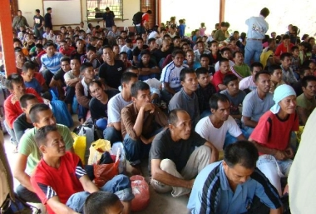

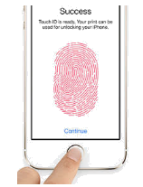

VALUE PROPOSITION
3
2
1
4
5
FUTURE
ECOSYSTEM
Social Welfare
PDRM
(POLICE)
Immigration officer
Insurance Company
NGO / United Nations
FUTURE
FUTURE
Health Care
Education
Private Sectors / Job Opportunities
E KYC
BLOCKCHAIN
Notes:
6

Slide 7
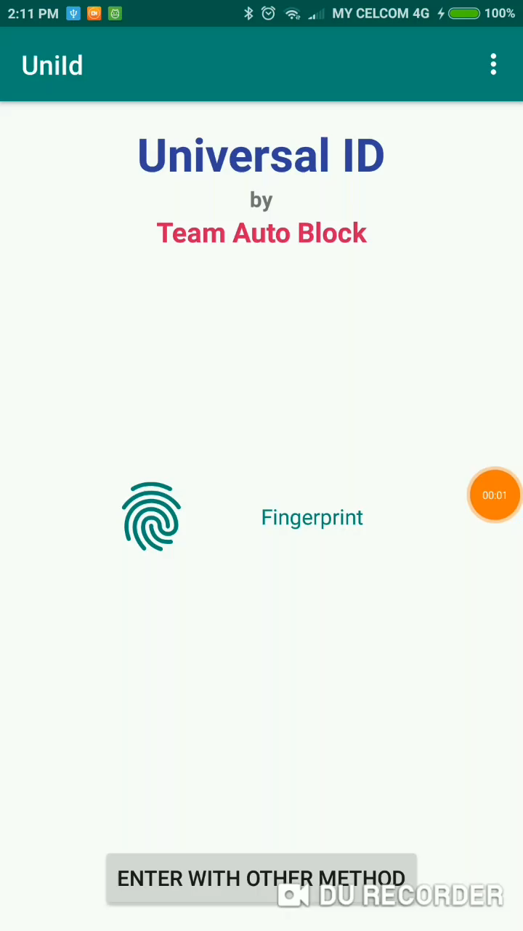
3
2
1
4
5
DEMO

Slide 8
3
2
1
4
5
Q & A

